Slide 1
University Senate
Project Updates
University Planning, Design and Construction
September 9, 2019

Slide 2
Projects Recently Completed: $250M+
The link to the detailed Project Updates information shared with the Senate Executive Committee is:
https://updc.uconn.edu/2019/09/06/sec-construction-update-september-2019/
Note: All projects have some degree of risk. Typically, projects in construction may have a risk to schedule and/or to budget; projects in design and planning may have a risk to scope and/or schedule and/or budget.
In this report, the assessment of the risk per project is shown with a green, yellow or red box as follows:
Least Risk
Some Risk
Most Risk

Slide 3
Projects in Construction/in Bidding: $340M+
Note: All projects have some degree of risk. Typically, projects in construction may have a risk to schedule and/or to budget; projects in design and planning may have a risk to scope and/or schedule and/or budget.
In this report, the assessment of the risk per project is shown with a green, yellow or red box as follows:
Least Risk
Some Risk
Most Risk
3

Slide 4
Projects in Design: ~$425M
Note: All projects have some degree of risk. Typically, projects in construction may have a risk to schedule and/or to budget; projects in design and planning may have a risk to scope and/or schedule and/or budget.
In this report, the assessment of the risk per project is shown with a green, yellow or red box as follows:
Least Risk
Some Risk
Most Risk

Slide 5
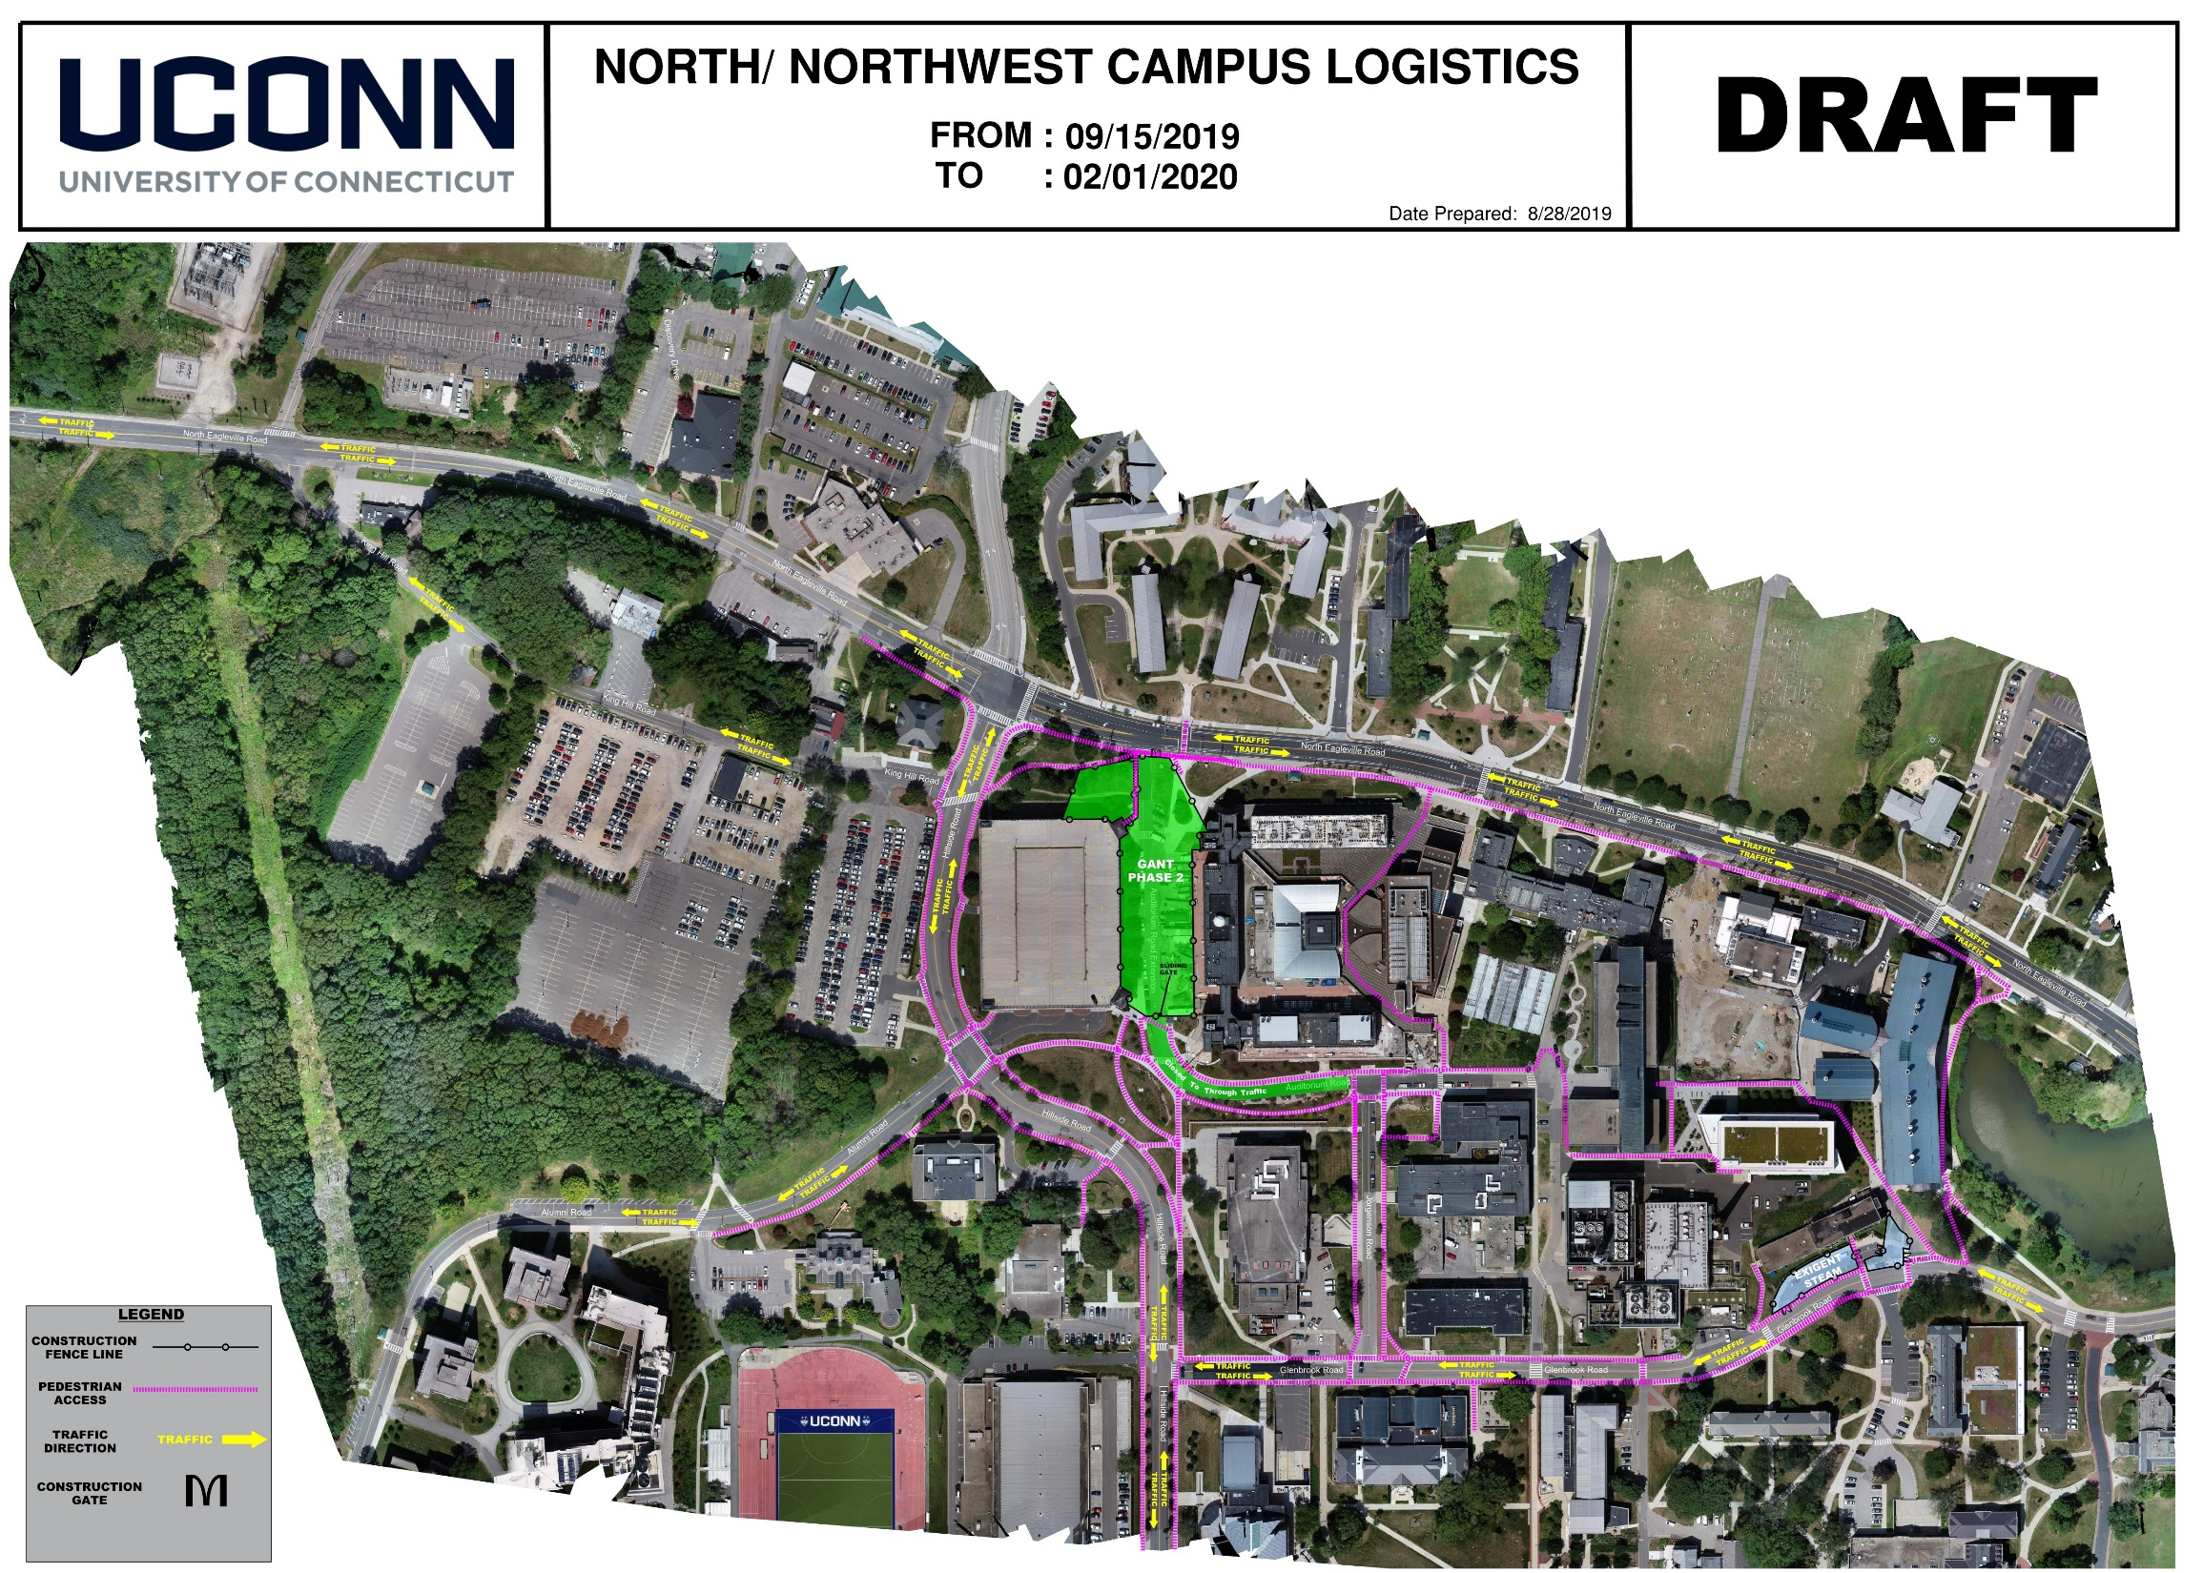
Global Logistics Map

Slide 6
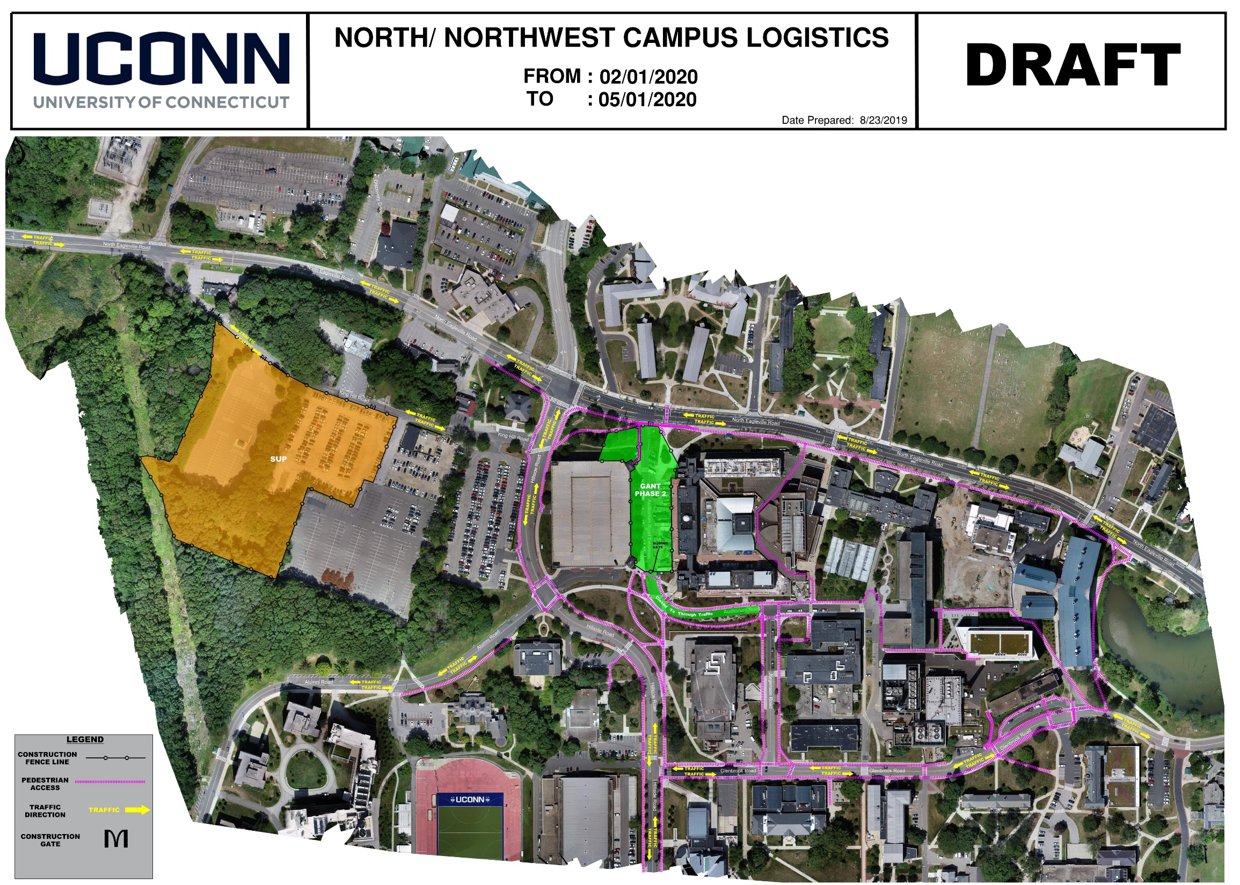
Global Logistics Map

Slide 7
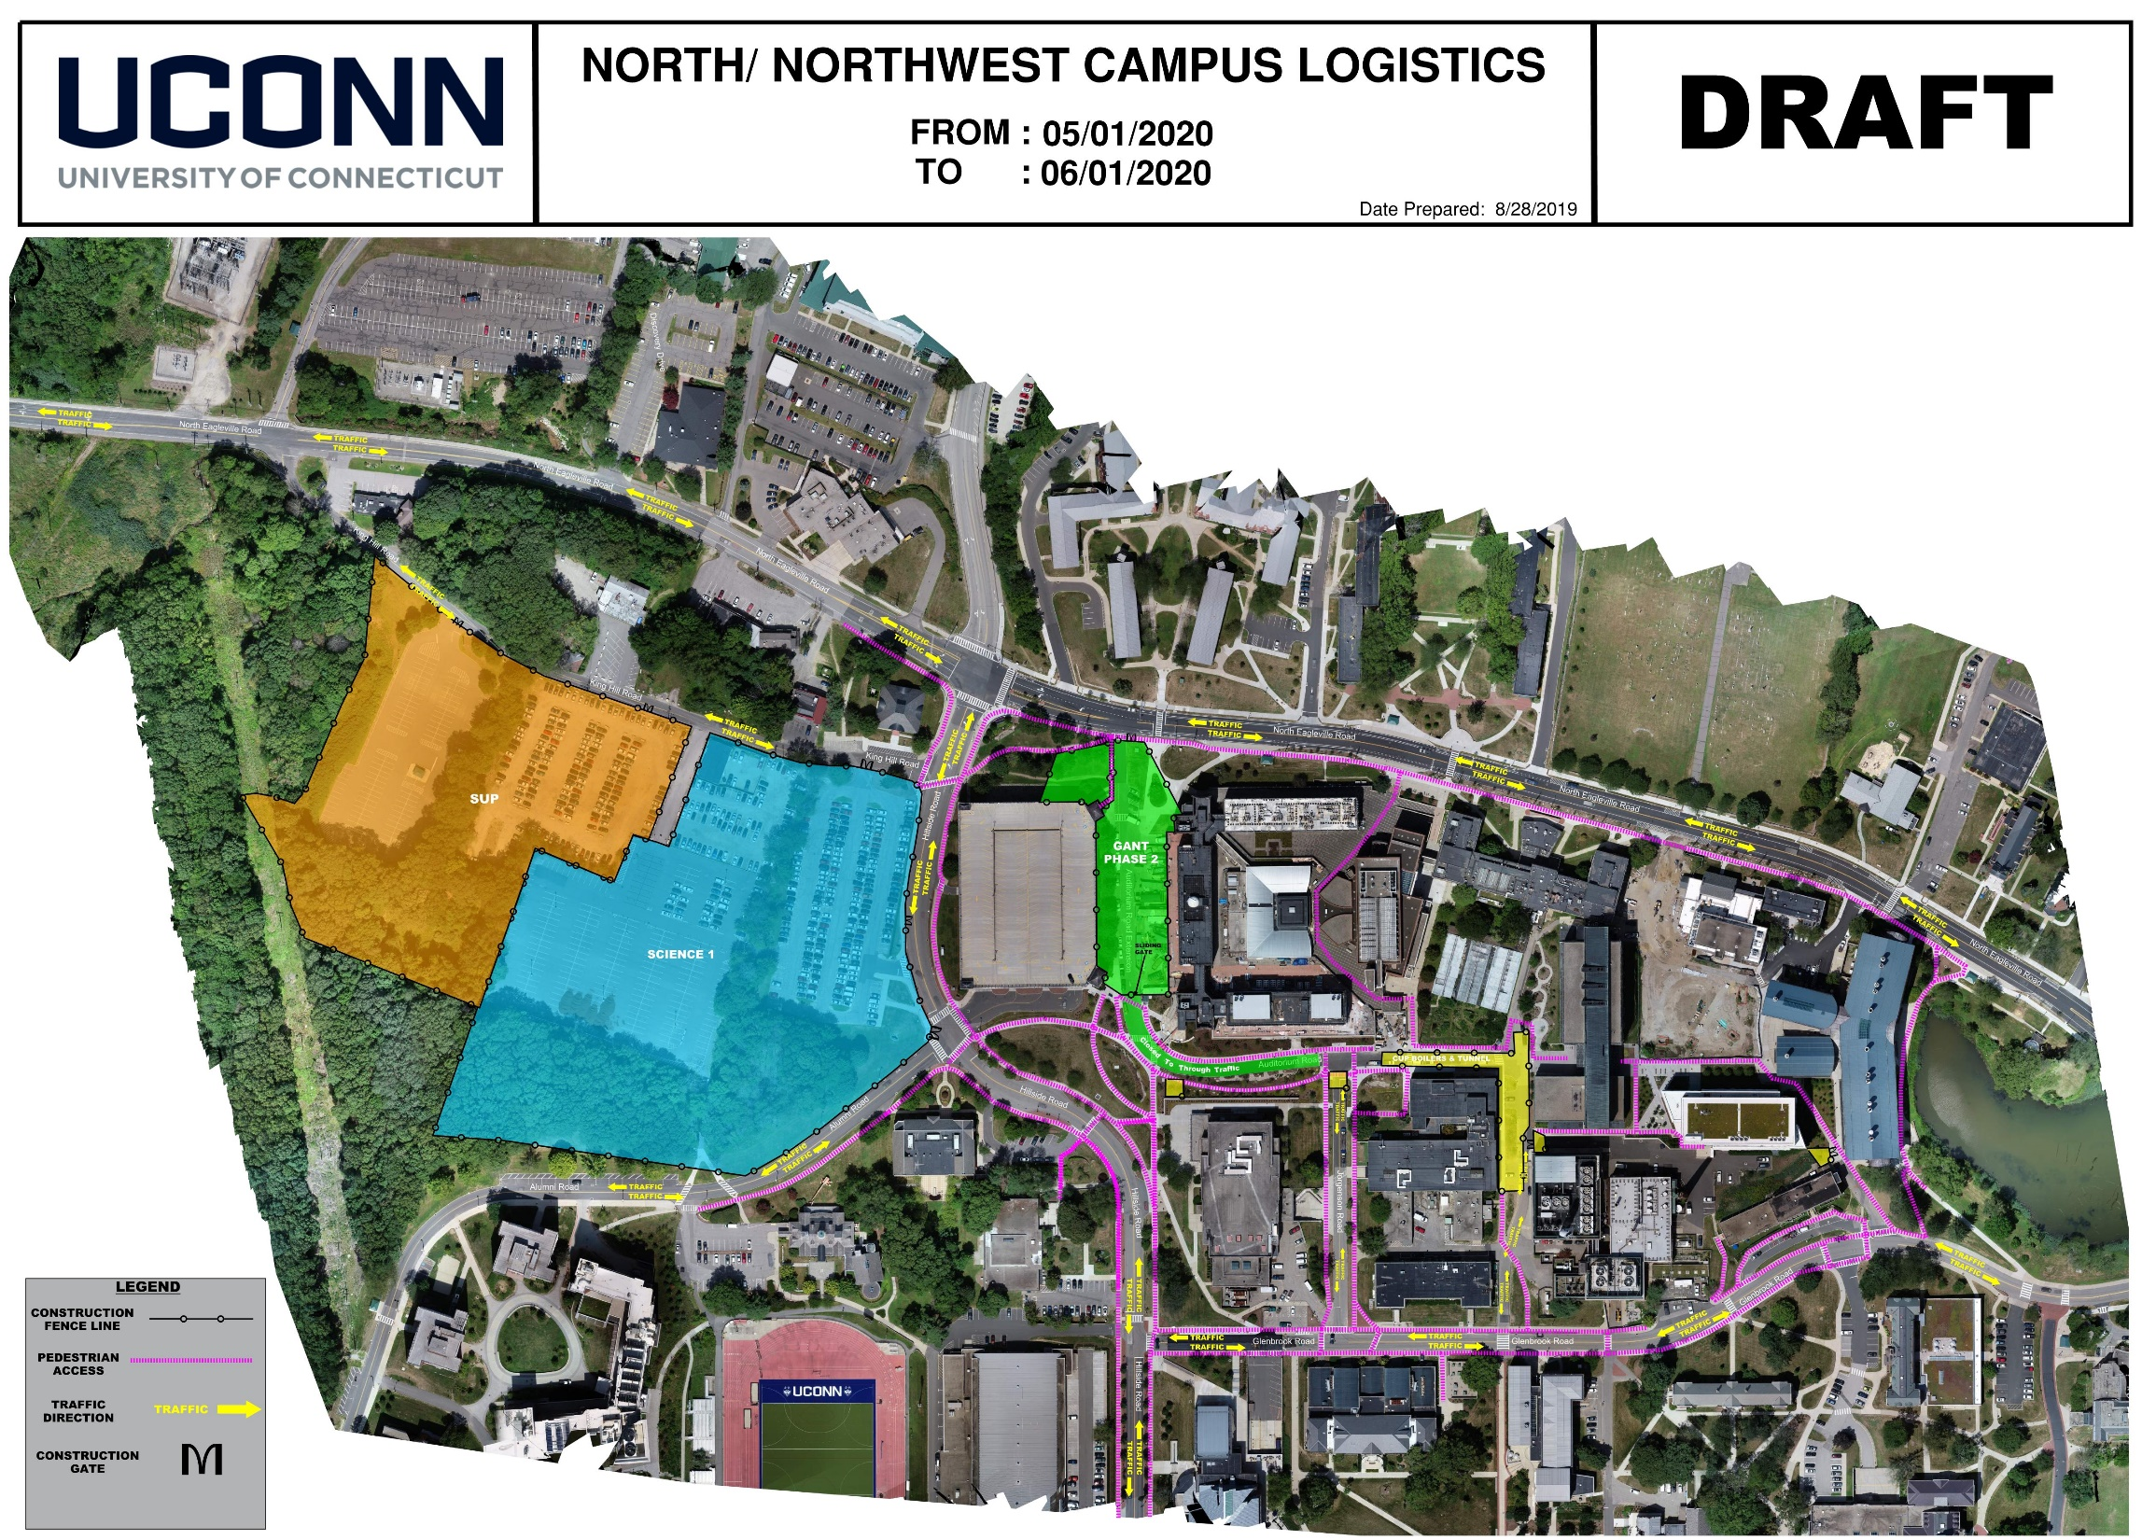
Global Logistics Map

Slide 8

Global Logistics Map

Slide 9

Global Logistics Map

Slide 10

Global Logistics Map

Slide 11

Global Logistics Map

Slide 12

Global Logistics Map

Slide 13
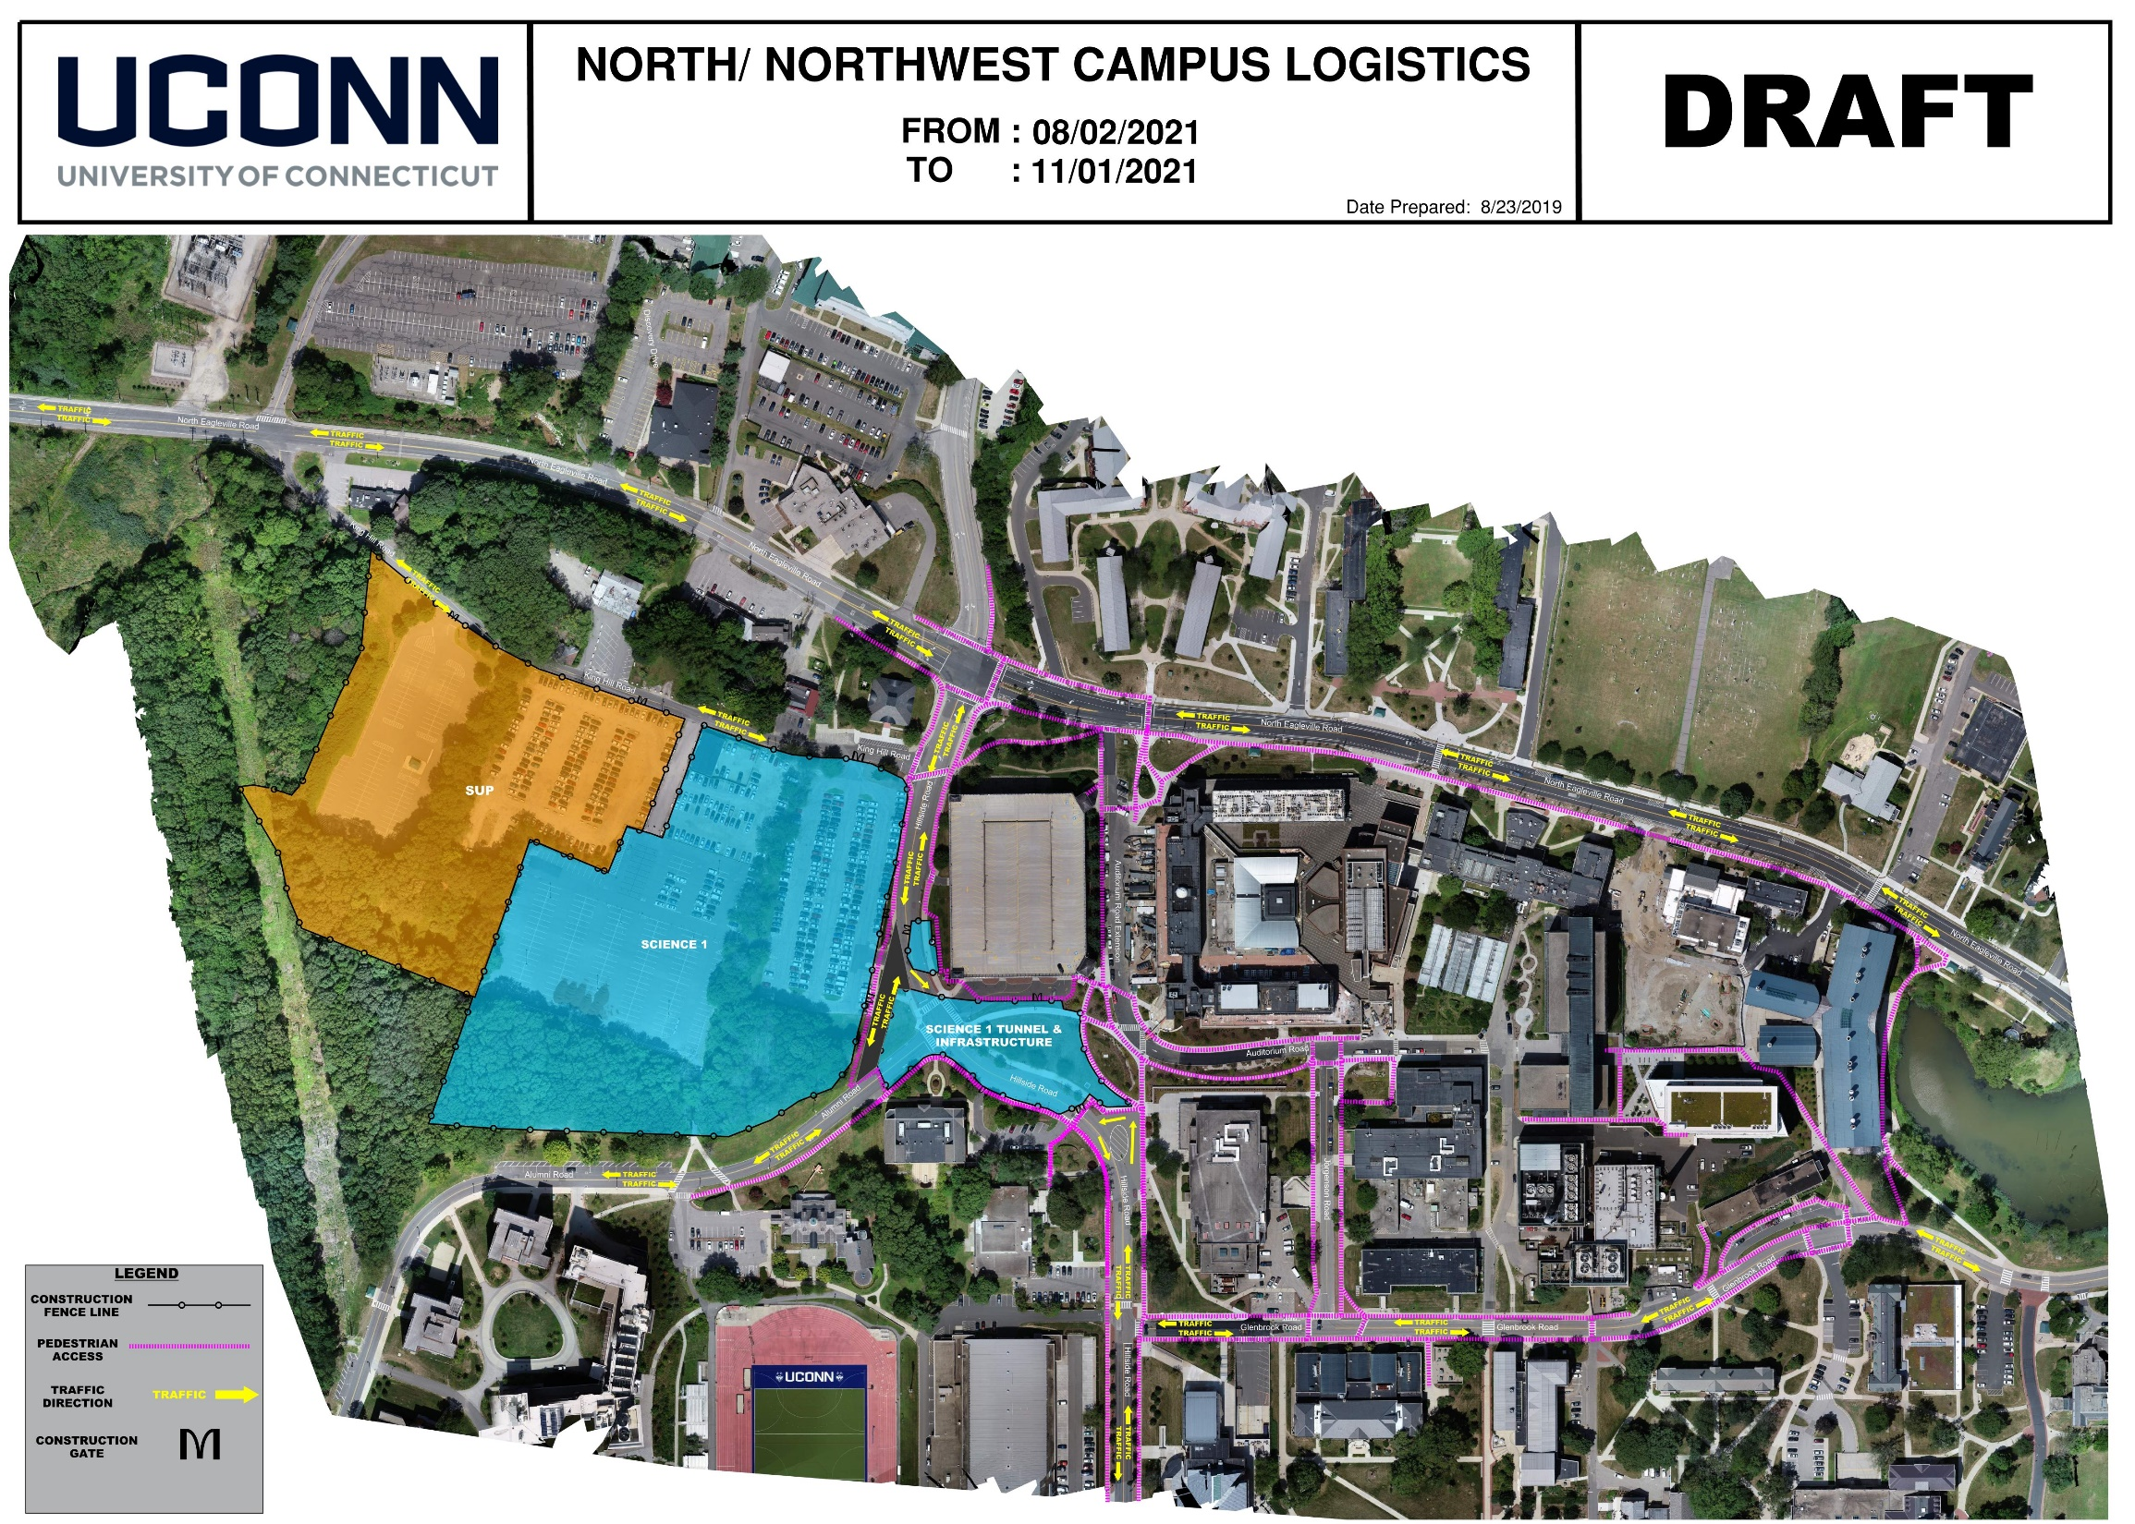
Global Logistics Map

Slide 14
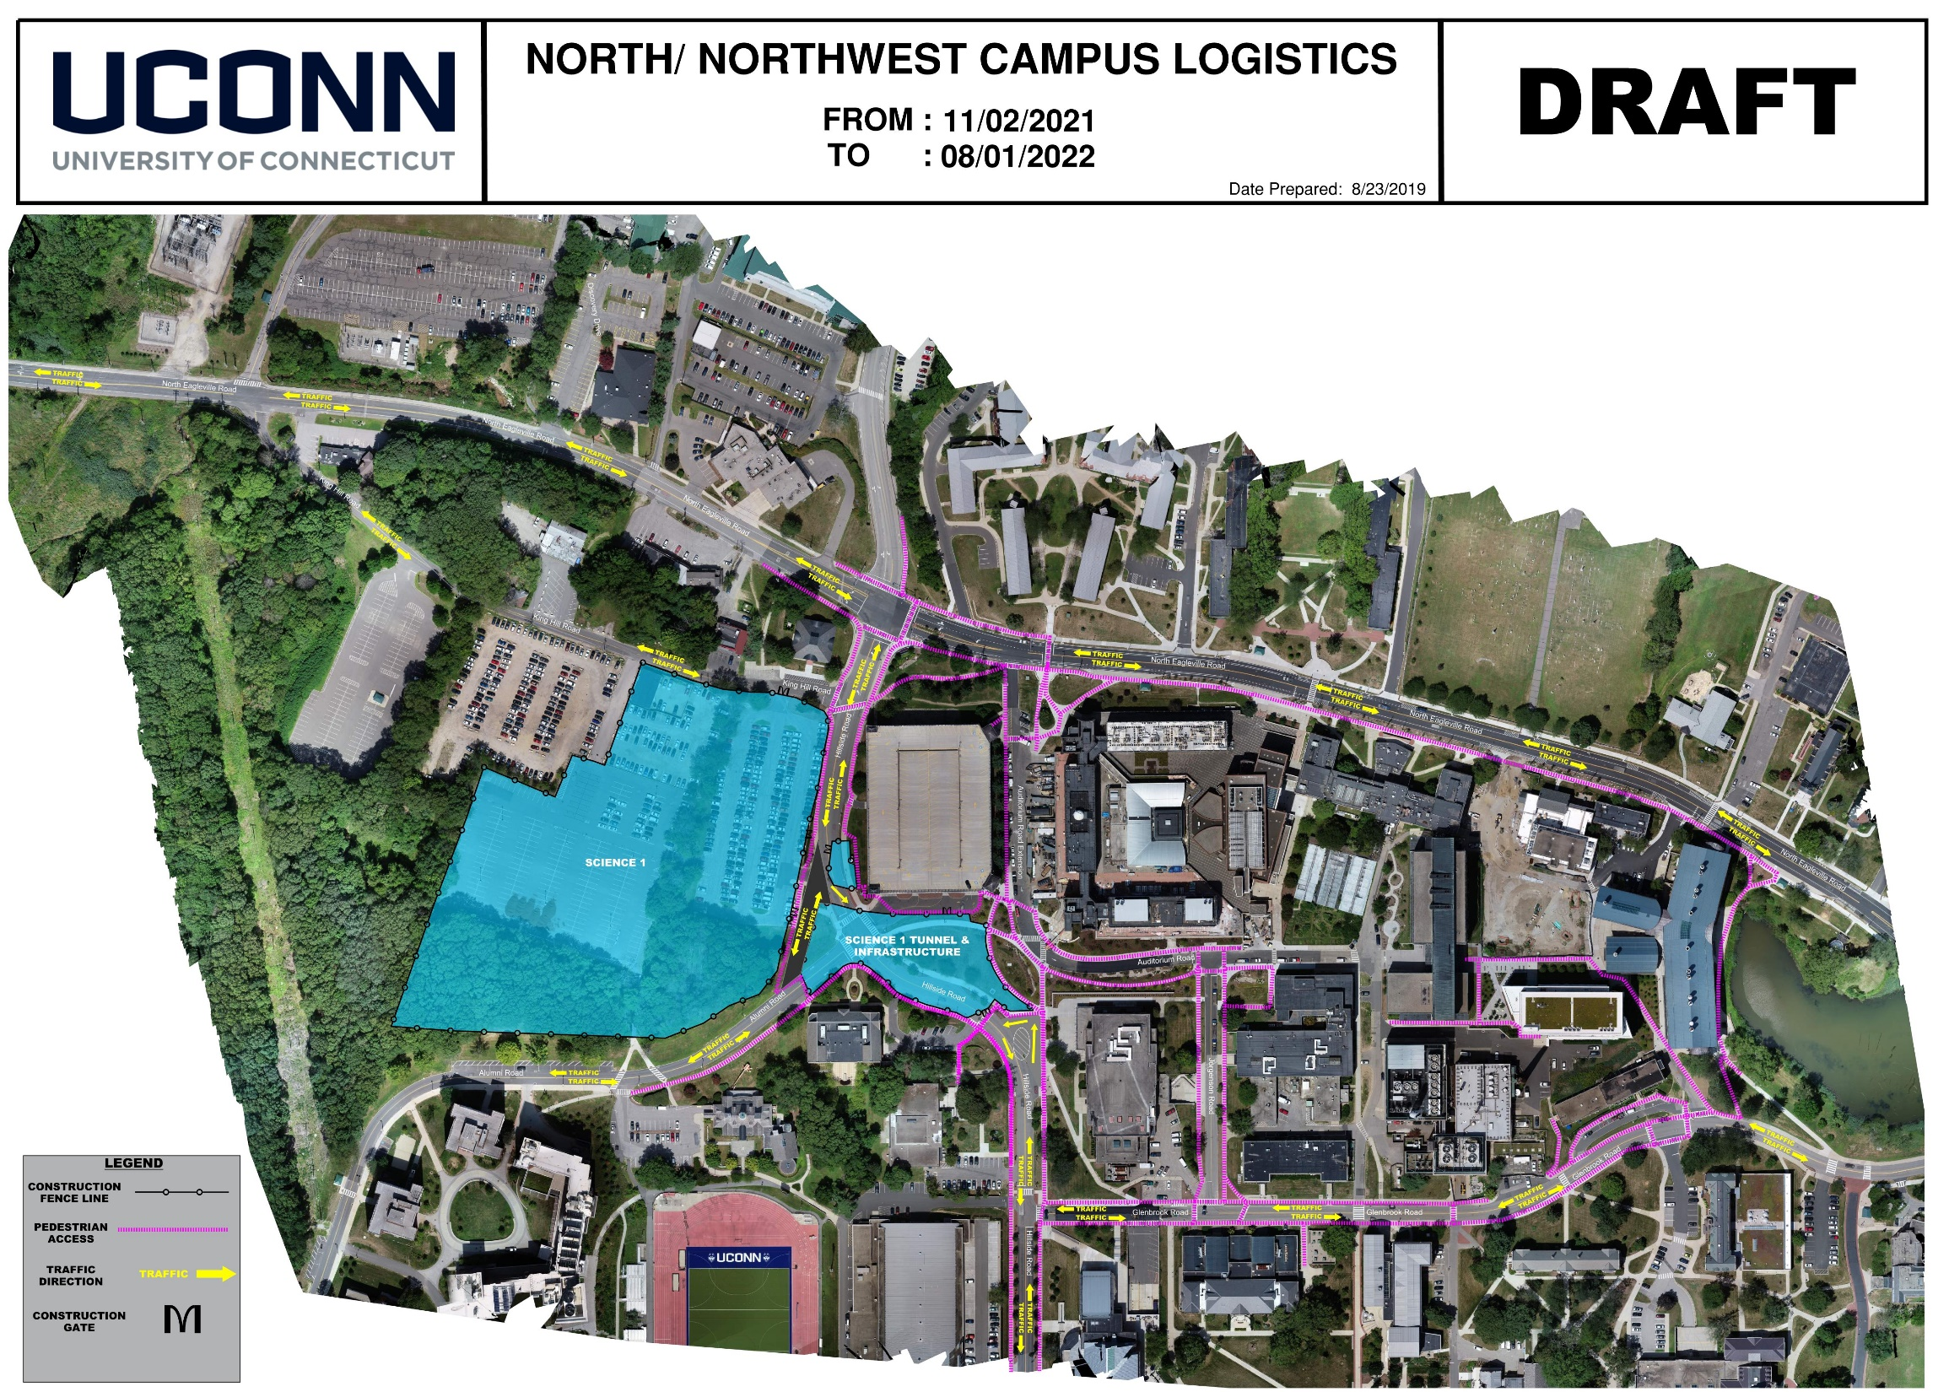
Global Logistics Map

