Slide 1
University Senate Meeting
UConn Student Mental Health: Services, Campus Culture, and Next Steps
Suzanne Onorato, PhD, Executive Director
Student Health & Wellness
April 6, 2020

Slide 2
University Senate Meeting
UConn Student Mental Health
Agenda:
Mental Health Services
Creating a Culture of Wellness at UConn
President’s Task Force on Mental Health and Wellbeing
Questions

Slide 3
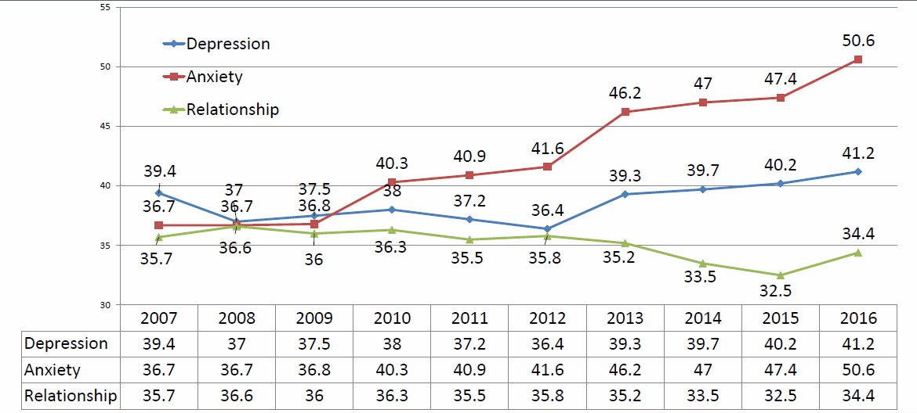
National Student Mental Health Trends 2007-2016
Changing Student Needs - Challenging Collegiate Mental Health Services
2016 Association for University and College Counseling Center Directors Annual Survey
79% increase in students treated for mental health issues in past year from 2007 to 2017
64% increase in students with lifetime mental health diagnosis from 2007 to 2017
Healthy Minds Study, 2018
Notes:
Agreement that there is a change in utilization and in acuity; more research needs to be done on why and what to do about it.

Slide 4
2017 ACHA-NCHA Student Survey
National vs. UConn Responses
 | National (SP17) | UCONN (SP17)
Overwhelmed by all you had to do | 87.0% | 87.2%
Very sad | 67.3% | 68.7%
Very lonely | 62.2% | 63.5%
Overwhelming anxiety | 60.8% | 61.4%
Things were hopeless | 51.1% | 52.1%
So depressed difficult to function | 39.1% | 40.3%
Seriously considered suicide | 10.3% | 9.7%
Intentionally injured self | 7.0% | 6.8%
Attempted Suicide | 1.5% | 1.3%
* In the past 12 months

Slide 5
SHaW Mental Health Services Total Encounters and Clinical Staff FY15 - FY19
29% Increase
28% Increase
* NOT including 5.5 FTEs for Regional Campuses

Slide 6
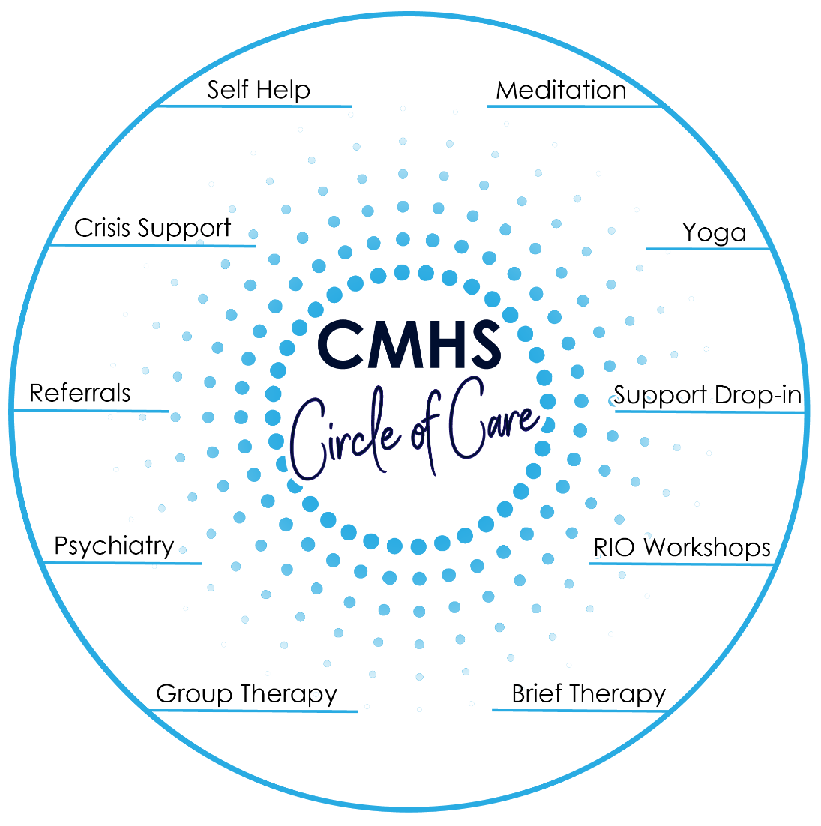
SHaW-MH Stepped Care Model – Implemented in 2017
Traditional Services:
Brief Individual Therapy
Group Therapy
Psychiatry
Rapid Access Services:
Single Session
Drop-In Support
Self-Help
Skill Building Services:
Yoga
Meditation/Biofeedback
Mindfulness Workshops
Transitional Services:
Crisis Support
Referrals

Slide 7
Stepped Care Model – Implemented in 2017
2014-15 2015-16 2016-17 2017-18 2018-19

Slide 8
Enhancing the Student Experience
Implementing Student Requests:
Evening Hours
In-Person Triage (in Addition to Phone Triage)
Electronic Scheduling
24/7 In-Person On-Call All Year Round

Slide 9
What Is the Optimal Model of Care?
Need to Commit to a Model of Mental Health Care to Address Evolving Student Needs
Keeling Review:
Align UConn Model of Care with Emerging Best Practices
Provide an Operational Review of Mental Health Services
Recommendations for Promoting a Holistic Vision of Wellness
Final Report with Action Plan

Slide 10
JED Campus
Baseline Assessment Question
Which of the following characterizes your school's approach to promoting and protecting the emotional health (including substance abuse and suicide prevention) of your students?
All or almost all of the responsibility lies within the counseling service; other departments are relatively uninvolved.
The counseling service has responsibility, but other departments and stakeholders also provide some input and/or support.
Emotional health is seen as a campus-wide issue with significant involvement from multiple campus departments and stakeholders.

Slide 11
2019-2020 Coalition Structure
Wellness Coalition Advisory Council
AOD Collaborative
JED Campus & Mental Health
Innovate Student Wellness
Academic Affairs Partnership
URC Advisory Council
Suicide Prevention
Innovate Wellness Case Competition

Slide 12
University Senate Meeting
UConn Student Mental Health
President’s Task Force
Student Mental Health & Wellbeing
Co-Chairs: Eleanor JB Daugherty & Nina Rovinelli Heller
projectwellness.uconn.edu
Community Wellness: Prevention and Partnerships
Mental Health Continuum and Coordination of Services
Diversity and Inclusion: Culture, Language, Workforce
Training and Research

Slide 13
University Senate Meeting
UConn Student Mental Health: Services, Campus Culture, and Next Steps
Questions?

