Slide 1
UConn Library University Senate Report
Dean Anne Langley
December 5, 2022
Notes:
8 locations
93 staff
3.2 million physical volumes (including 1.7 million books, and 140,000 audio-visual materials)
1,200 archival and manuscript collections
210,000 rare books
1.5 million digital images of unique materials
450+ research databases searched over 2 million times
1 million ebooks
190,000 scholarly journals
731,743 page views on lib.uconn.edu from over 173 countries in over four dozen languages
3,583 research questions/consultation
Total Items borrowed in 2019 – 32,029 and in 2020 – 26,492

Slide 2
University Initiatives
Focus on the Whole Student
Increased the number of Babbidge Booths
Added to the Wellness Collection
Programming on getting study help, meditation, and reducing stress
Advancing Open at UConn
New wordmark and toolkit
Website updates for access to information

Slide 3
University Initiatives
Future of Journals
Third of the five-year project to support sustainable scholarship by exploring and implementing alternative means of accessing scholarly information – from journal model to article model
Elsevier cancellation effective this spring
Up Next
Socialize the project and website updates
Fine tuning the access interface
Prepare for and implement the non-renewal of Taylor & Francis & Wiley Online

Slide 4
Strategic Initiatives
Student Employee Support
Evaluating and supporting Library student employees through the lens of UConn’s Life Transformative Education Initiative
Recognizing students during Student Employee Appreciation Week
Expanding Our Collections
Small Connecticut businesses archival collection
Building a Zine Collection
Internal Improvements
Building a culture of communication
Clarify evolution of non-W undergraduate classes and impact on library usage
Long-term changes to library functions and services resulting from the pandemic
UConn Library Action Committee for Inclusion (ULACI)

Slide 5
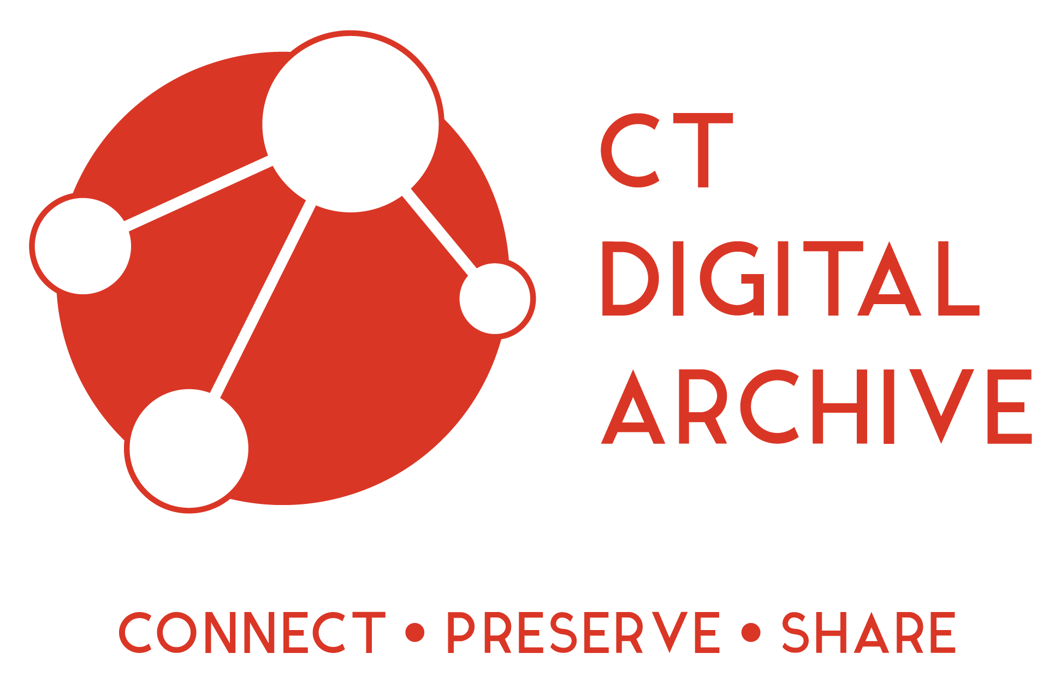
Highlights of Impact Across CT and Beyond
The Connecticut Digital Archive (CTDA) collections surpassed 3 million objects from more than 80 institutions in Connecticut with more than 3 million visitors in FY ’21
Received a Connecticut Humanities Partnership Grant of $173,711 for My Town, My Story, outreach focused on building digital collections at the local level across Connecticut, connecting to people who don’t typically interact with memory organizations but have a story to tell

Slide 6
Staffing Challenges
At the start of
Fiscal Year 2024,
nearly 60% of staff
will have been at the UConn Library
for 5 years or less
Currently have approximately 20 vacancies
Numbers do not include special payroll

Slide 7
2022-2023 Goals
Goal 1: Continued Strategic Hiring
Focus on using open positions to create a more diverse and highly skilled workforce that helps meet our mission to be the Right Library for UConn
Goal 2: Integrating the UConn Library’s Strategic Framework
Engage and advance the Strategic Framework in our daily work
Goal 3: Strengthen our commitment to ourselves as we continue to be the Right Library for UConn
Be proactive and responsive in meeting the university’s needs, through experimentation and continuous improvement by engaging with and assessing ourselves and our community

Slide 8
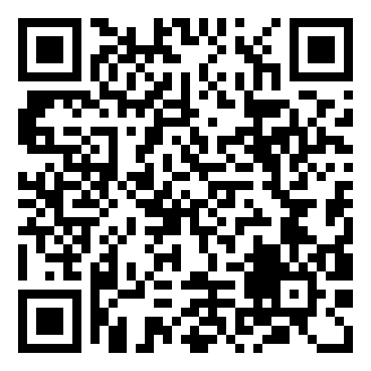
LibQUAL+ Survey through Association of Research Libraries (ARL)
Sent to all students, faculty, and staff
Measures “library service” across three main areas: space, resources/access, and customer service
Provides a gap analysis between desired service, what they can live with, and where we are now
Primary survey weakness: it’s long and a bit cumbersome to take
Primary survey strengths: rich data that reaches across services and is longitudinal
Soft ending through December 9, may run longer if necessary

