Slide 1
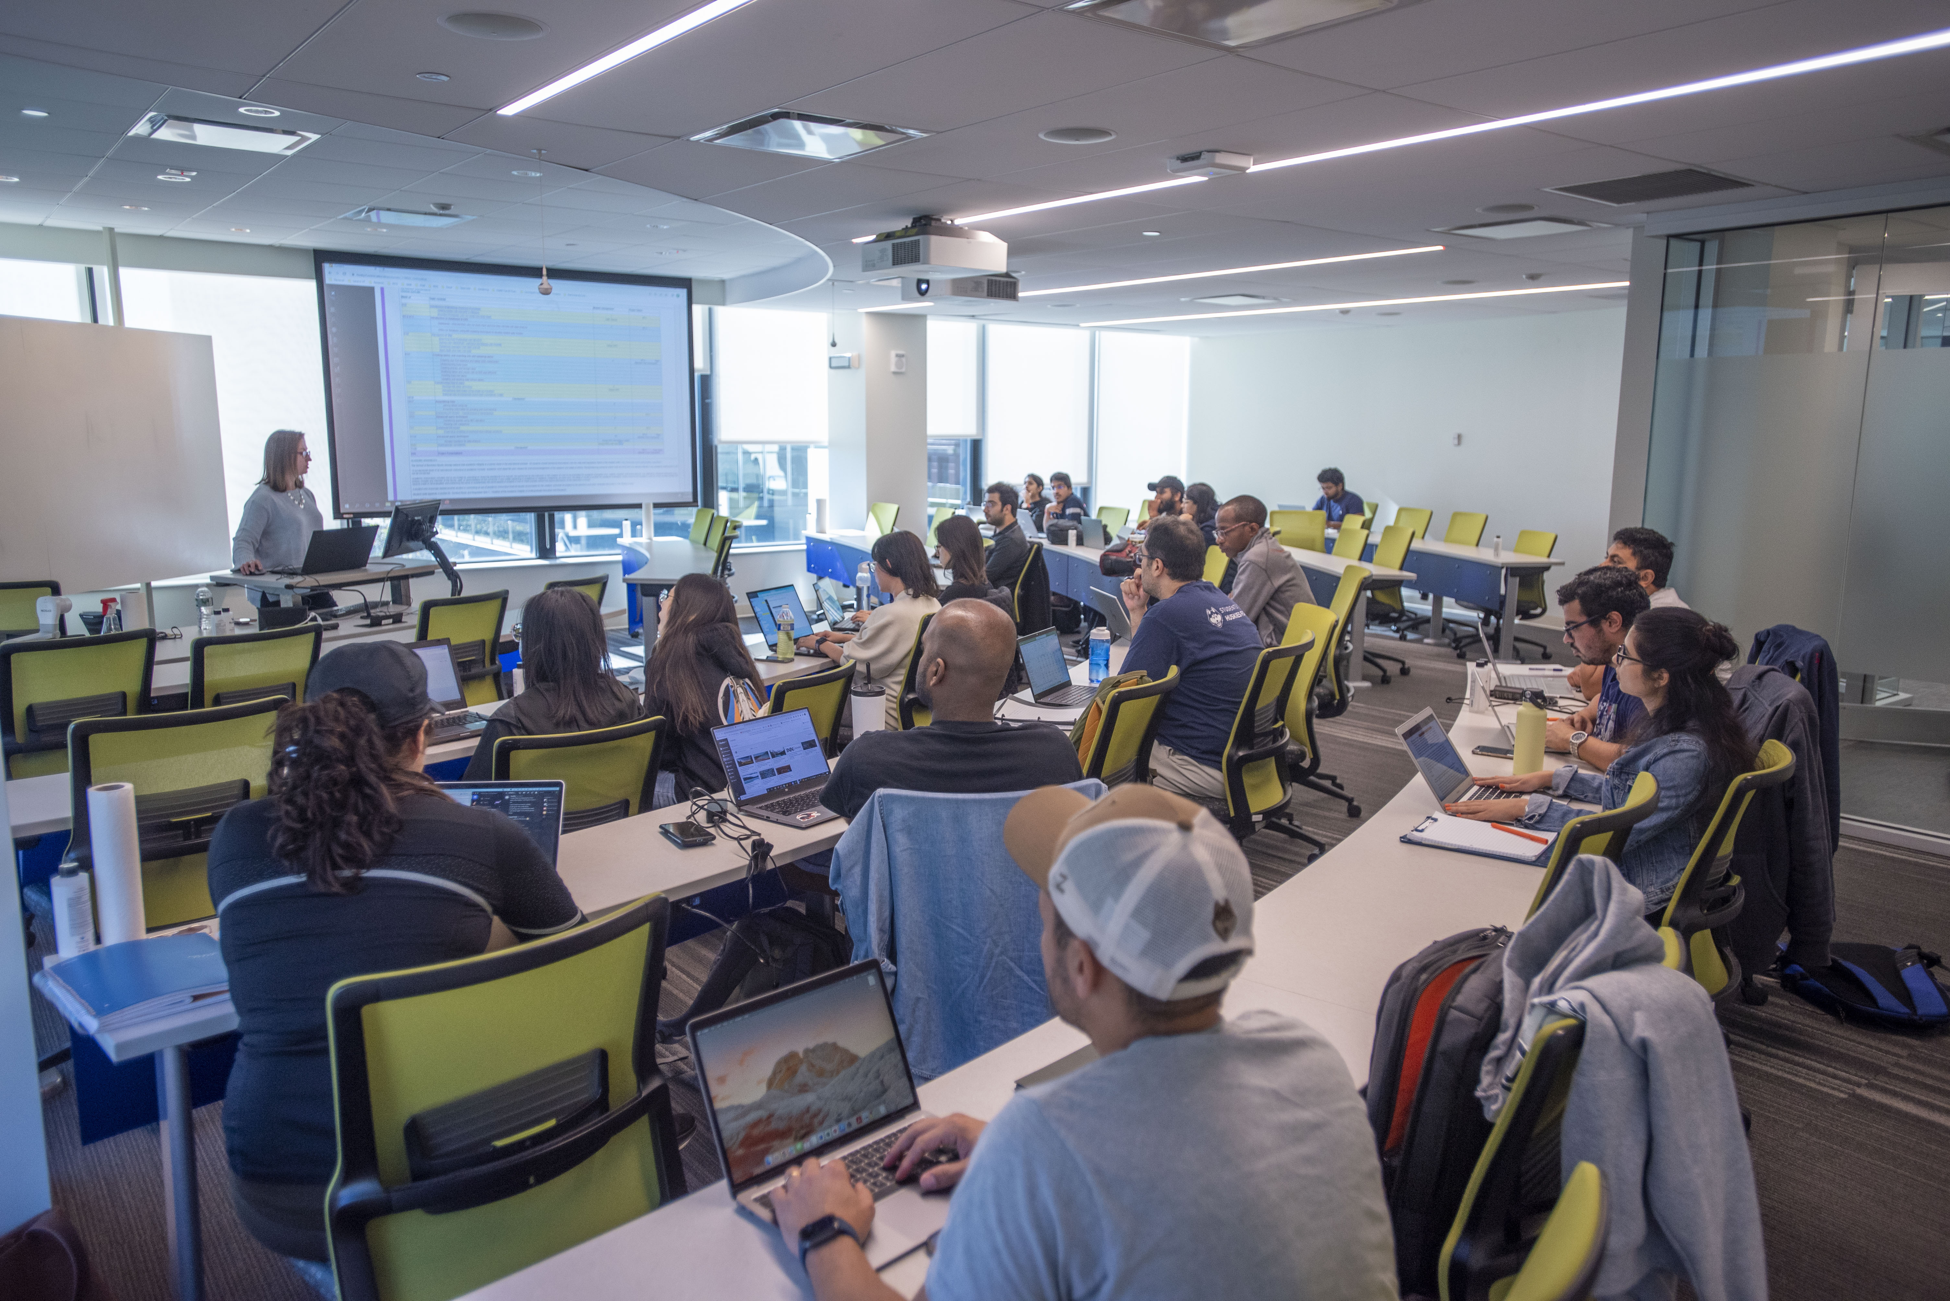
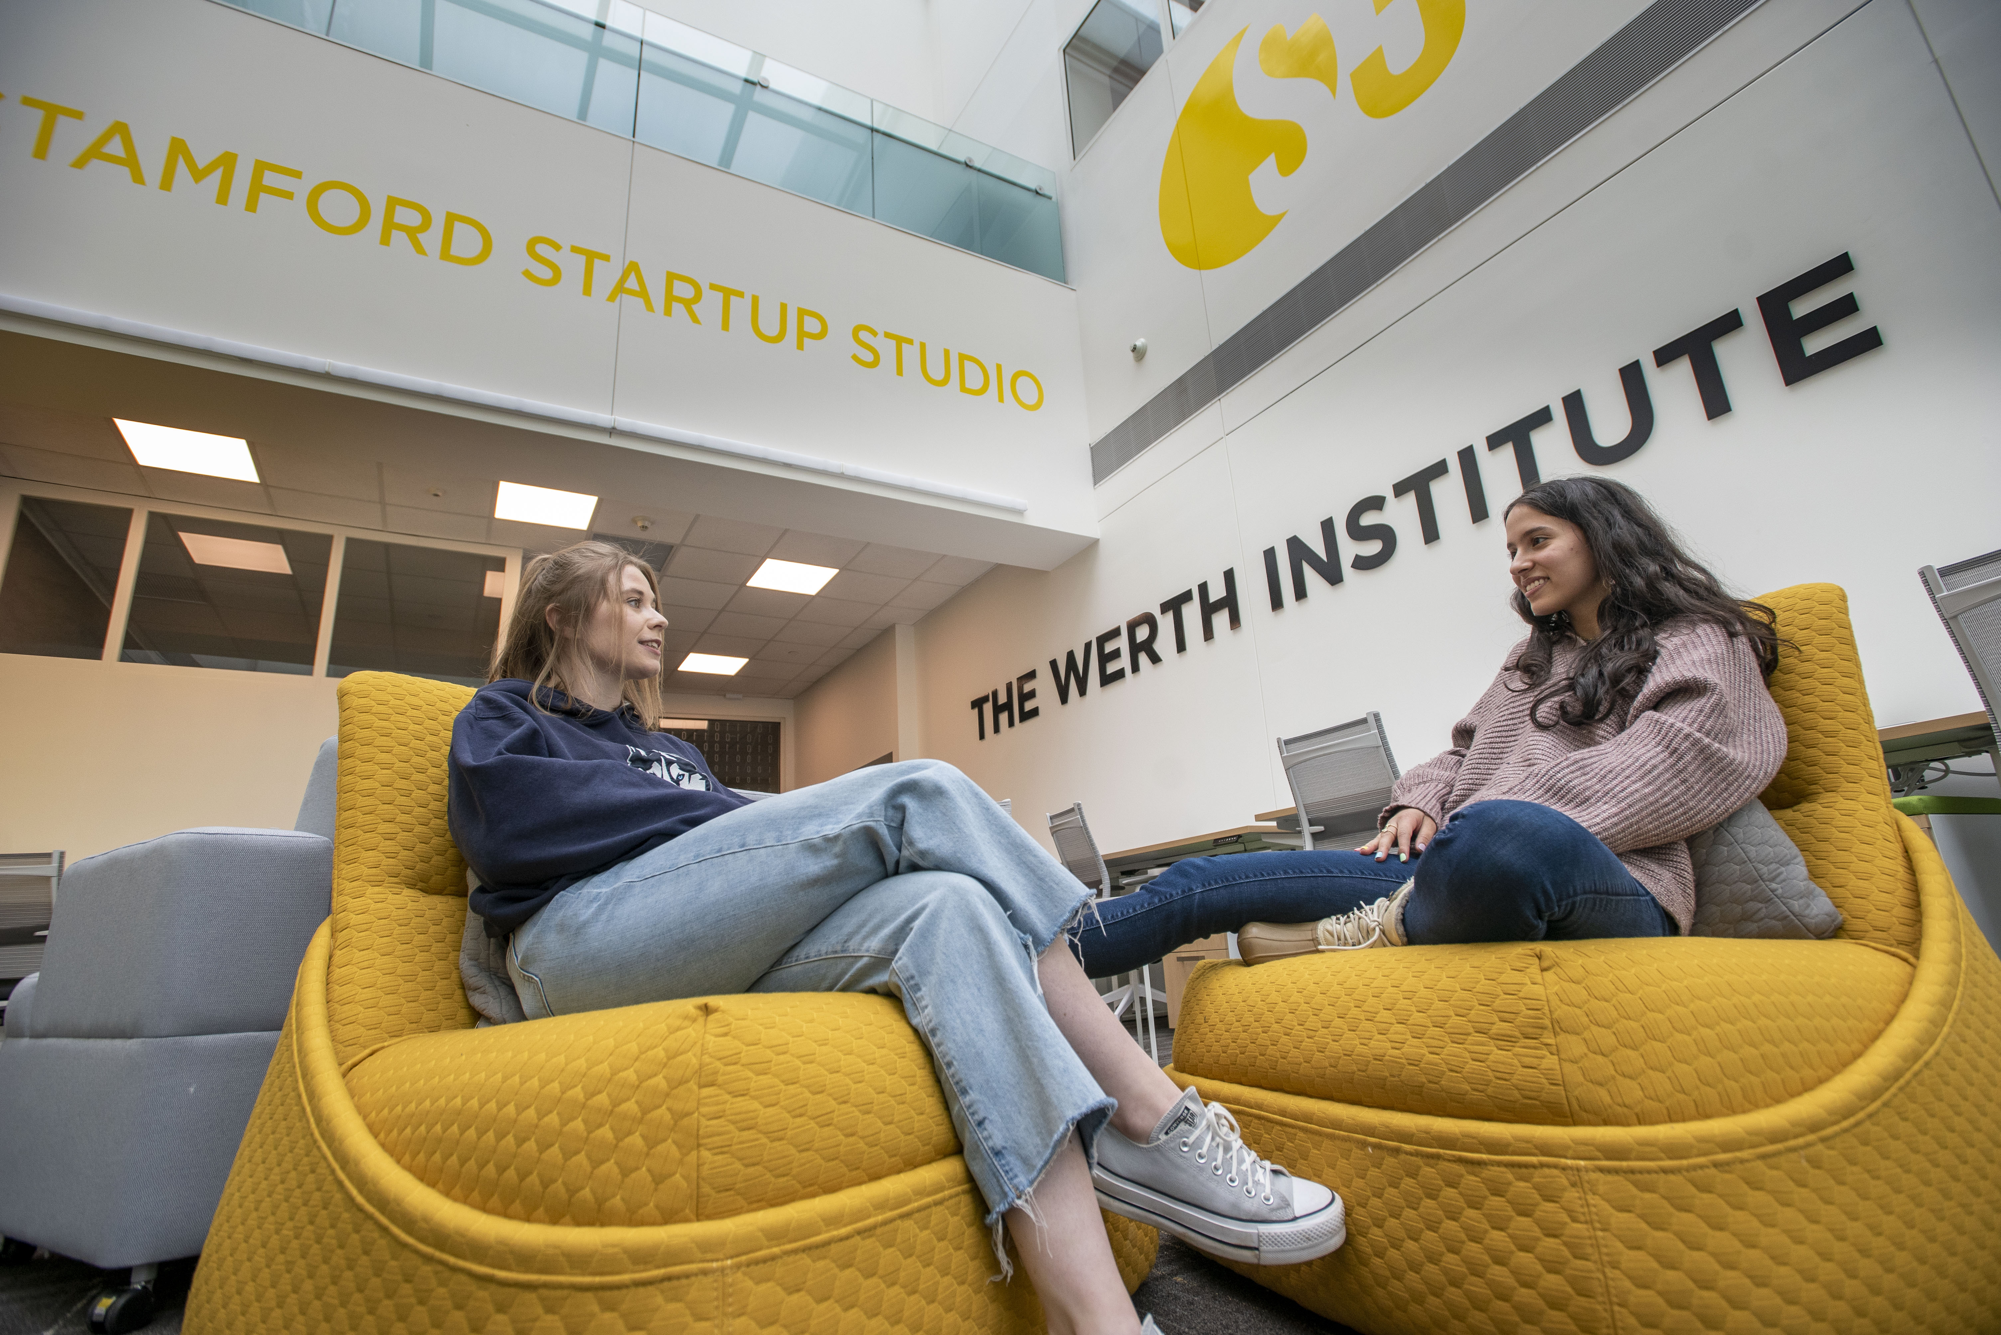
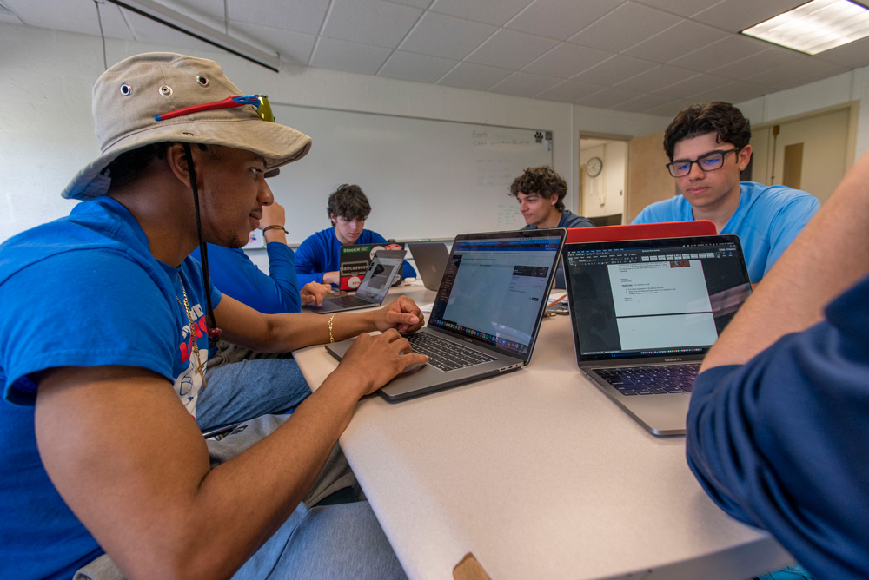
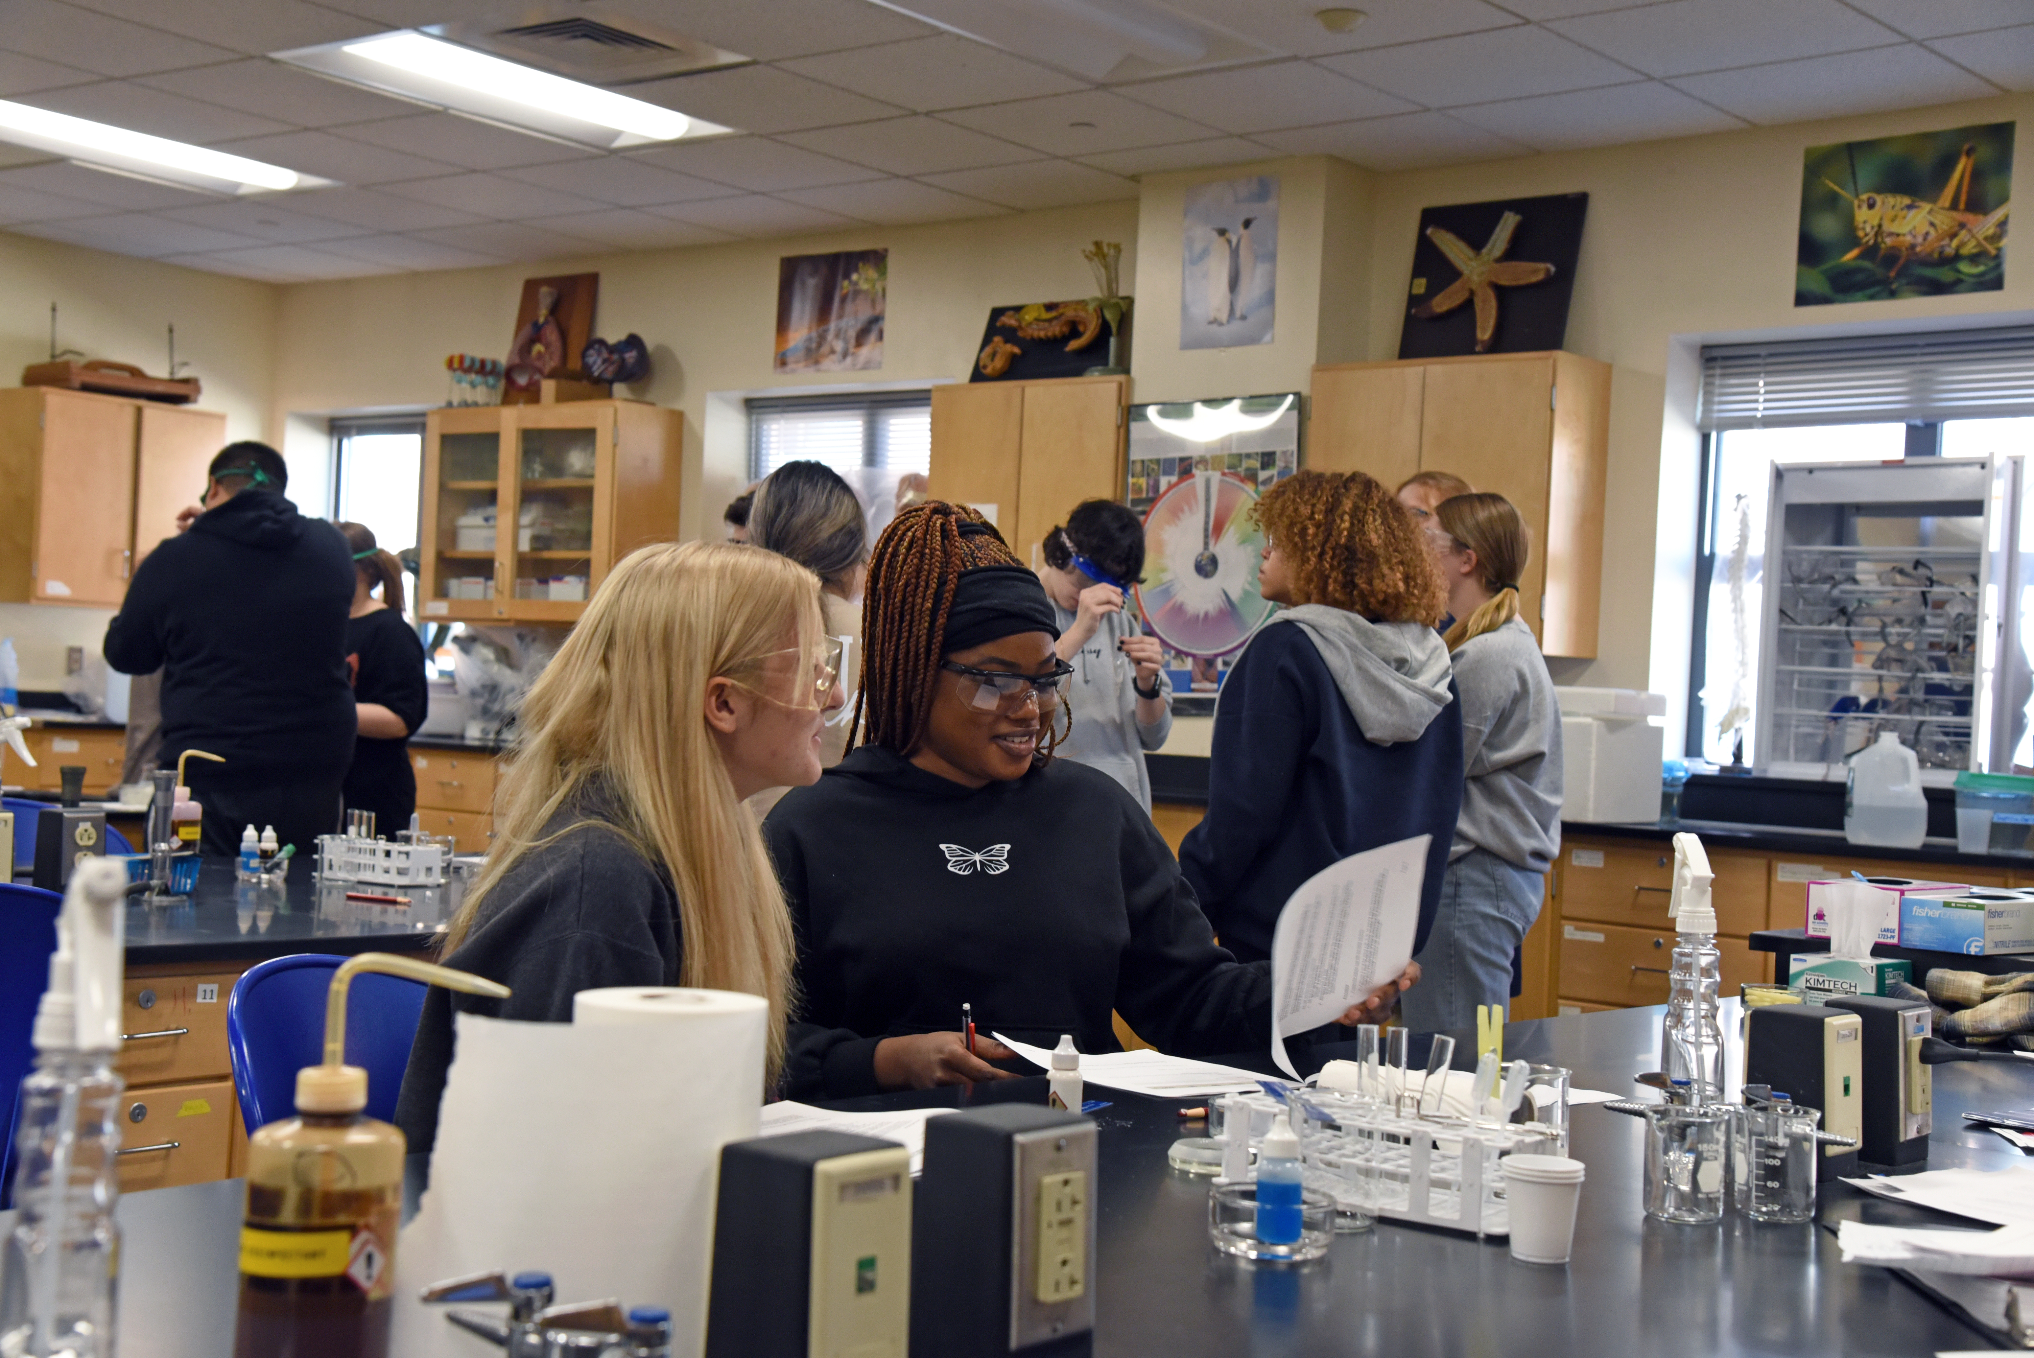
UConn's Multiple Campuses
Avery Point
Hartford
Stamford
Waterbury
STUDENTS FIRST, UCONN ALWAYS, HUSKIES FOREVER

Slide 2
AVERY POINT
Enrollment Trends
Degree Programs
Undergraduate 4-Year Degrees
English
General Studies
Marine Science
Maritime Studies
Graduate Programs
Degrees and Certificates Offered In
Engineering
Nursing CEIN
Oceanography
Teacher Certification
Notes:
Add university benchmark. 8 year enrollment slide.

Slide 3
AVERY POINT
Fall 2022
Student Success
First Generation Students: 42% (University: 35%)
Graduation Rates
Pell Eligible Students: 34% (University: 28%)
 | 4 Year | 6 Year
Fall 2016 entering class | 45% | 59%
Fall 2017 entering class | 39% | 44%
University Average (Fall 2016) | 66% | 78%
Retention Rates
 | % Retained after 1 year
Fall 2020 Entry | 76%
Fall 2021 Entry | 79%
University Average (Fall 2021) | 87%
DFW Rate Fall 2017 – Spring 2022
Undergraduate | 9%
University Average | 7%
Notes:
Add university benchmark. 8 year enrollment slide.

Slide 4

AVERY POINT
Research Landscape
CT National Estuarine Research Reserve (CT NERR)
Partnerships with:
National Institute for Undersea Technology (NIUVT)
Mystic Aquarium,
Connecticut’s Initiative for Environmental Research of Offshore Wind,
Connecticut Institute for Resilience and Climate Adaption (CIRCA)
Student Success
Avery Point Academic Center (APAC) provide tutoring in every subject area and to provide mentoring to struggling students, Avery Point athletes and students looking for extra support.
FYE Program including the chance for upperclassman to become Mentors and teach alongside a faculty or staff member
Diversity, Equity, Inclusion & Justice (DEIJ)
Avery Point Diversity and Equity Committee (AP DEI) is comprised of a dedicated group of faculty, staff, and students engaged in building a safe and inclusive community by promoting events and opportunities for all campus members.
In partnership with CAPS, the campus will again host Upward Bound students on campus during the summer and expand engagement through a new three-year ConnCap grant.
Community Outreach & Engagement
Husky Harvest Food Pantry opened January 17, 2023. In the first six weeks, Husky Harvest had 196 student visits from 90 unique users. Currently, over 296 family members are being served by this resource.
Currently, Avery Point is in discussion to support general education requirements for students of the United States Coast Guard Academy and New London High School with dual enrollment classes at Avery Point.
Teaching Excellence
Office of Academic Affairs: Working with the academic departments, the Center for Teaching and Learning and other relevant offices, provides faculty with opportunities for development and training. In collaboration with Avery Point faculty, the APAC works closely with students to provide tutoring in every subject area and struggling students, Avery Point athletes and students looking for extra support.

Slide 5
HARTFORD
Enrollment Trends
Degree Programs
Undergraduate 4-Year Degrees
School of Business
MBA
MS HRM
MS BAPM
MS Financial Risk Management
Certificates:
Accounting Analytics
Business Analytics
Digital Marketing Strategy
Accounting Fundamentals
Health Care Analytics
Health Care Finance and Insurance
Human Resource Management
Project Management
Corporate and Regulatory Compliance
Long-term Health Care Management
School of Social Work
MSW Program
Advanced Standing Program
PhD Program
Urban Service Track
SFA
MFA in Arts Leadership & Cultural Management
CLAS
Fast Track in Public Policy
MPA
MPP
MA Survey Research
Certificates:
Leadership & Public Mgmt
Nonprofit Management
Public Financial Management
Survey Research
Business Data Analytics
English
Public Policy
Financial Management
General Studies
HDFS
Individualized Studies Program
Marketing Management
Psychological Sciences
Social Work
Urban and Community Studies
Graduate Programs
Neag School of Education
Connecticut Teacher Certification
MA Curriculum and Instruction
MA Educational Psychology

Slide 6
HARTFORD
Fall 2022
Student Success
First Generation Students: 48% (University: 35%)
Graduation Rates
Pell Eligible Students: 45% (University: 28%)
 | 4 Year | 6 Year
Fall 2016 entering class | 41% | 59%
Fall 2017 entering class | 44% | 52%
University Average (Fall 2016) | 66% | 78%
Retention Rates
 | % Retained after 1 year
Fall 2020 Entry | 78%
Fall 2021 Entry | 76%
University Average (Fall 2021) | 87%
DFW Rate Fall 2017 – Spring 2022
Undergraduate | 13%
University Average | 7%

Slide 7

HARTFORD
Research Landscape
Research on Resilient Cities, Racism, and Equity (formerly SGCI)
2021-2023 grant applications total ~$4.5m
Awarded ~$2.98
Future grant applications anticipated ~3m
Other Research Infrastructure
School of Public Policy and Institute for Municipal and Regional Policy
School of Social Work
Rudd Center for Food Policy and Healthy
Health Disparities Institute
Student Success
Academic Achievement Center: Incorporating innovative and data informed best practices to coach, mentor and train students, faculty & staff
Services:
Drop in Coaching
Supplemental Instruction
Presentations & Workshops
UConn Connects
Diversity, Equity,
Inclusion & Justice
(DEIJ)
Truth, Racial Healing, and Transformation (TRHT) Campus Innovation Hub
Community Outreach & Engagement
Development of UConn Interdisciplinary Community CoLab Center
An interdisciplinary space that brings together university students, faculty, and staff along with members of the greater Hartford community to identify, diagnose and find solutions to societal challenges. The center will serve as a catalyst for research and entrepreneurship for units across UConn including Health, Social Work, Law, Business, Extension, and other urban community and justice-oriented programs.
Teaching Excellence
Office of Academic Affairs:
Develops and maintains an environment that promotes excellence in teaching and learning
In collaboration with CETL:
Hartford Matters Teaching Mini Grant
Community Collaborations Grant

Slide 8
STAMFORD
Enrollment Trends
Degree Programs
Undergraduate 4-Year Degrees
Graduate Programs
Business Data Analytics
Communication
Computer Science
Digital Media Design
Economics
English
Financial Management
General Studies
History
HDFS
Marketing Management
Political Science
Psychological Sciences
Sociology
School of Business
MBA
MS BAPM
MS Financial Technology
Certificate in Financial Technology
School of Nursing CEIN
Neag School of Education
Connecticut Teacher Certification
MA Curriculum and Instruction
MA Educational Psychology

Slide 9
STAMFORD
Fall 2022
Student Success
First Generation Students: 54% (University: 35%)
Graduation Rates
Pell Eligible Students: 49% (University: 28%)
 | 4 Year | 6 Year
Fall 2016 entering class | 43% | 61%
Fall 2017 entering class | 33% | 40%
University Average (Fall 2016) | 66% | 78%
Retention Rates
 | % Retained after 1 year
Fall 2020 Entry | 77%
Fall 2021 Entry | 81%
University Average (Fall 2021) | 87%
DFW Rate Fall 2017 – Spring 2022
Undergraduate | 10%
University Average | 7%

Slide 10

STAMFORD
Research Landscape
Full-time faculty research in each unit
Research grants/Fellowships in HDFS and History
Family Resilience and Mindfulness Empowerment (FRAME) Lab
Monthly Faculty Colloquia
Student Success
Academic Advising Center
Tutoring Center (Q and W)
ISS Center for Access Center for Access and Post-Secondary Success
Career Services Center
Center for Students with Disabilities
Mental Health Resource Center
Honor’s Program
Leadership Certificate
Student membership at YMCA
Husky Harvest
Diversity, Equity, Inclusion & Justice(DEIJ)
Active student organizations focused on diversity
La Communidad Intellectual (Fall ’23)
Affinity Center
Community Outreach & Engagement
4,640 internship opportunities within 30-mile radius of Stamford
Synchrony Digital Technology Center on campus
Partnership with Stop & Shop for Husky Harvest
Teaching Excellence
Center for Excellence in Teaching and Learning
Faculty Council
Faculty mentor program (beginning Fall ’23)

Slide 11
WATERBURY
Fall 2022
Student Success
First Generation Students: 55% (University: 35%)
Graduation Rates
Pell Eligible Students: 48% (University: 28%)
 | 4 Year | 6 Year
Fall 2017 entering class | 41% | 48%
Fall 2016 entering class | 39% | 57%
University Average (Fall 2016) | 66% | 78%
Retention Rates
 | % Retained after 1 year
Fall 2020 Entry | 78%
Fall 2021 Entry | 76%
University Average (Fall 2021) | 87%
DFW Rate Fall 2017 – Spring 2022
Undergraduate | 12%
University Average | 7%

Slide 12
WATERBURY
Enrollment Trends
Degree Programs
Undergraduate 4-Year Degrees
Graduate Programs
Allied Health Science
American Studies
Business Administration
Business Data Analytics
English
General Studies
Human Development and Family Sciences
Psychological Sciences
Urban and Community Studies
School of Nursing
Certificate Entry into Nursing (CEIN)
Neag School of Education
Connecticut Teacher Certification
MA Curriculum and Instruction
MA Educational Psychology
School of Business
MBA

Slide 13








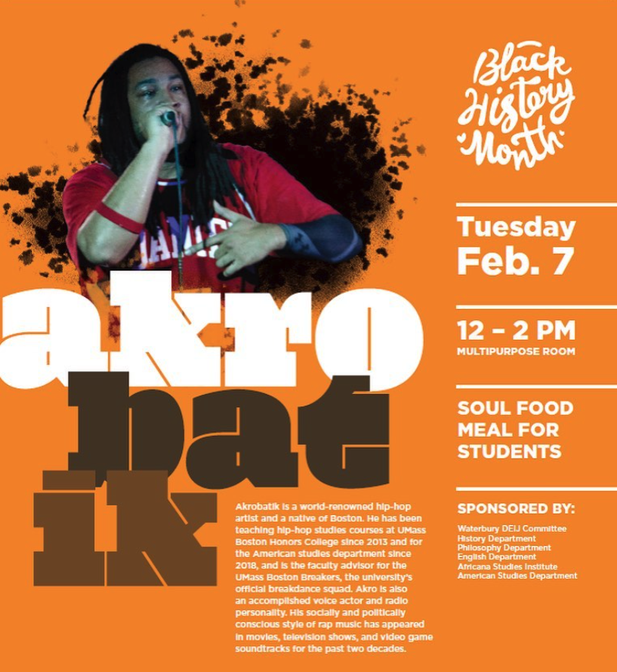
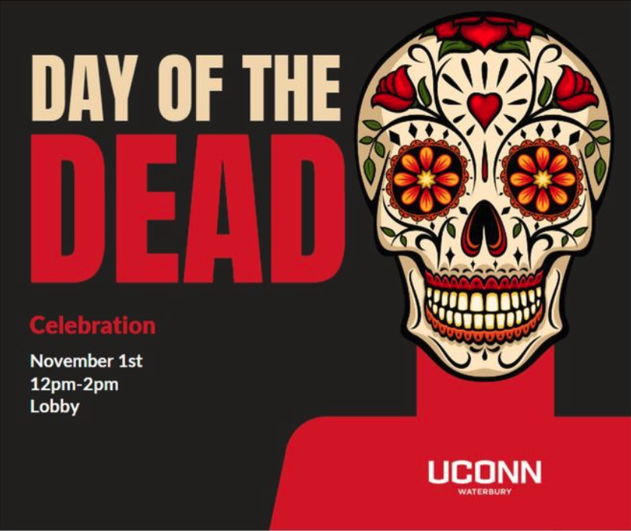
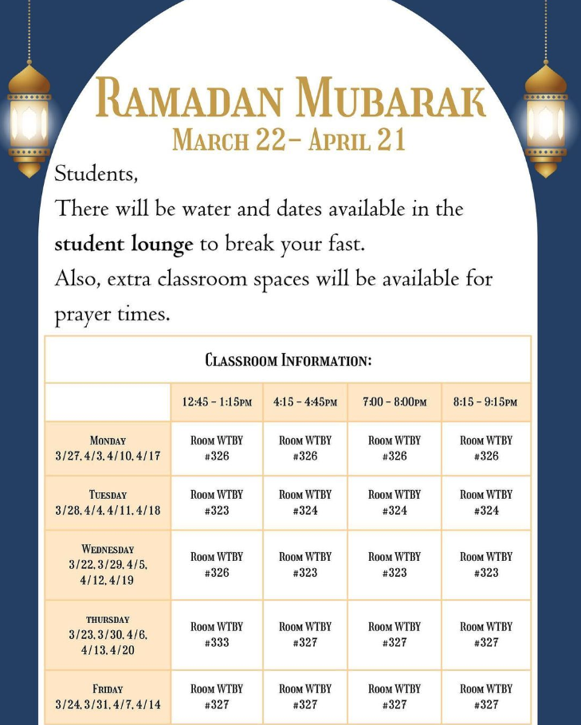

WATERBURY
Research Landscape
Promote research strength in neuroscience, biology, mental health, public health & humanities. Supported by NIH R01 & foundation grants.
Expansion of space to 7 rooms for 5 labs in Fall ’22-
Collaboration with Storrs for community-based research (e.g., schools). Fall ‘22-
Part-time Assoc Dir for Research to support grant writing and coordination across campus. Funded by Provost’s Office. Spring ’23-
Planning for X-univ/campus research programs w Yale, Storrs, etc.
Student Success
Academic Achievement Center: Incorporating best practices to coach, mentor & train students, faculty & staff. Fall ‘23-
Plans to start STEM-Bridge, UNIV programs. $5m USDA pending. $2m NSF to-be-submitted.
Food Insecurity: (1) Husky Harvest, open 4d/wk. free. (2) $5 meal plan w Spirit Café, M-Thu 8a-6p (<50% of $ of Storrs). (3) Grab-n-go stations. Free. Fall ‘23-
Teaching Excellence
Life Transformative Education & Experience (LTE²) Innovation Award. For any areas of research, teaching, community & diversity. Must engage students (ideally FWS). 5 awards made to date. Funded by anonymous donor. Spring ’22-
Co-Creation with the Community
W.I.S.H. Fest: Waterbury Innovation, Sustainability & Health. Annual event in April with the City, NRWIB, WPS etc @ Campus & Palace Theater. High profile speakers, a panel, student exhibits, novel Career Expo. 1,000 attendees, including 700 WPS Gr8-12 students, a mega-open house. Funded by REED Endowment & NIH/NSF grants. Spring ‘23-
Central coordination of internship, paid by FWS or employer, in partnership with NRWIB. Fall ‘23-
Science / career outreach in middle/high schools & field trips. Fall ‘23-
Diversity, Equity, Inclusion & Justice (DEIJ)
Active committee. Budget increased to 5x since Fall ’21 when it started.
“Brass City, Golden Opportunities”

